Slide 1

Discounting & Profitability Diagnostic
A Diagnostic Analysis of Product Profitability and Discount Trends in Retail.

Slide 2
Introduction This project simulates a real-world profitability diagnostic for a national retail chain using Kaggle’s Superstore dataset. The objective is to assess margin erosion driven by discounting practices and identify underperforming product segments. Insights are delivered through a structured Tableau dashboard to support executive decision-making.

Slide 3
Business Challenge
Client Overview
Client: Superstore Retail
Industry: Office Supplies (National Retail Chain)
Duration of Data: 12 months of sales and transaction records
Client’s Core Concern:
"Sales look strong, but profit margins keep slipping. I need a clear picture of where we're losing money, especially at the sub-category level.
Are our pricing and promotional strategies aligned with long-term profitability?
I want a clean, visual, executive-ready dashboard that answers:
What’s working?
What’s not?
Where should we stop, fix, or invest?

Slide 4
Objectives & Methodology 1. Identify which product sub-categories are eroding profit margins. 2. Evaluate how discounting is impacting overall profitability. 3. Pinpoint operational inefficiencies contributing to declining profitability. 4. Surface actionable insights to guide pricing and performance strategy. 5. Provide a clear, visual dashboard for executive decision-making.

Slide 5
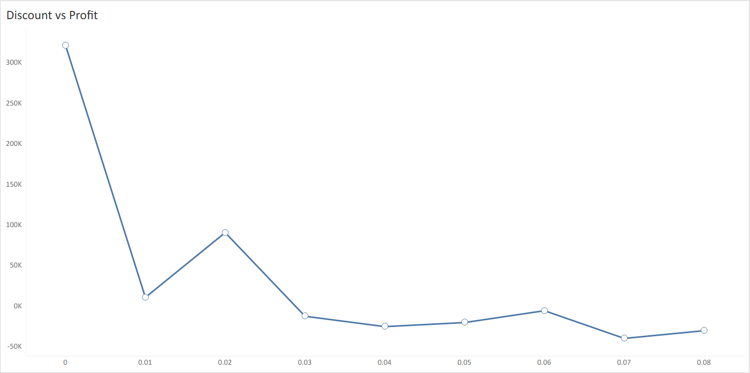
Quote

Slide 6
Aggressive Discounting Drives Losses in Key States Insight: Profitability declines consistently as discount levels rise, with tier 4 identified as the optimal threshold. Beyond this, further discounting leads to net margin erosion, making transactions financially unsustainable. Recommendation: Reduce reliance on discounting by improving cost efficiency. Focus on high-loss states like Texas, Ohio, and Pennsylvania by renegotiating supplier terms, optimizing shipping, and streamlining operations to protect margins without sacrificing competitiveness.

Slide 7
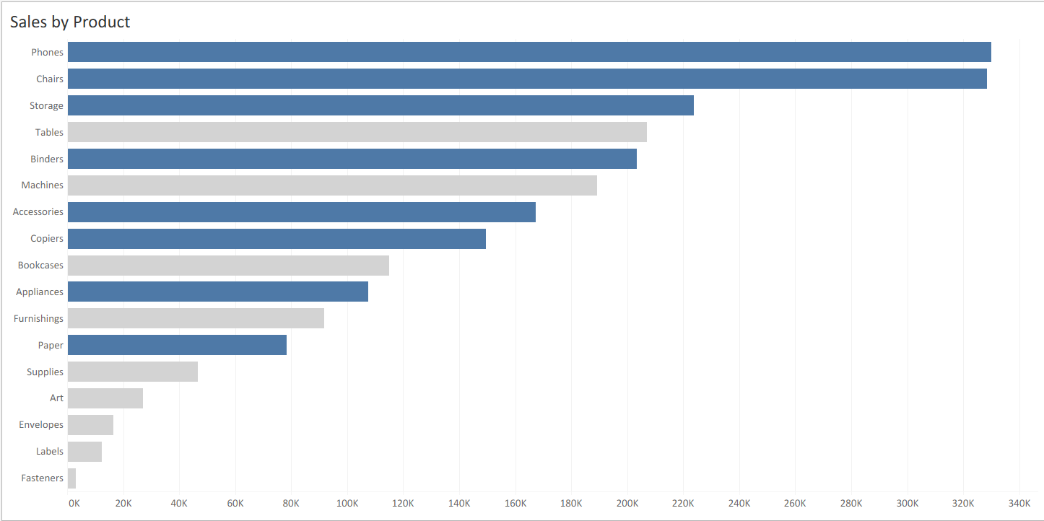
Quote

Slide 8
Productivity Pressure Is Driving Discount-Led Profit Decline
Insight:
High-performing product sub-categories like Tables, despite strong sales volume, are generating below-average profit margins. These categories are highlighted in gray to indicate subpar profitability relative to peers. This suggests that strong sales are being driven at the expense of profit — likely due to excessive discounting under pressure to meet sales targets.
Recommendation:
Rebalance incentive structures to prioritize profitability over volume. Introduce performance metrics tied to profit per sale, not just revenue, when evaluating employee performance, promotions, and bonuses. This will encourage a shift from aggressive discounting toward value-driven selling, improving margin sustainability across high-volume categories.

Slide 9
Thank You
Prepared by: Gyan Singh
B.Sc. Information Technology, Semester III
University of Mumbai, Mumbai
Date: July 2025
Contact: gyansingh.workmail.com
This project is built as a business analytics simulation
using Kaggle data and an AI-generated client case.

